Slide 1

A Hybrid SecureBERT-BiLSTM-Attention Model for Cyber Threat Intelligence Classification
PRESENTER: SAIKIRAN
STUDENT NUMBER: 3196603
MASTER OF SCIENCE IN COMPUTING SCIENCE | GRIFFITH COLLEGE DUBLIN
UNDER THE SUPERVISION OF : ABUBAKR SIDDIG
SEPTEMBER 2026

Slide 2
1. Problem Statement
Core Cybersecurity Triage Bottlenecks
CTI reports are largely unstructured.
Manual categorization is time-consuming.
Entity-rich cybersecurity text is difficult to classify.
Need an accurate automated classification framework.
⚠ Vocabulary Mismatch
Cyber terms represent out-of-vocabulary anomalies to models trained on general web text, causing poor embedding quality.
⚠ Missing Standardized Labels
CTI narratives are descriptive, meaning supervised models cannot be trained without first constructing a validated target class.

Slide 3
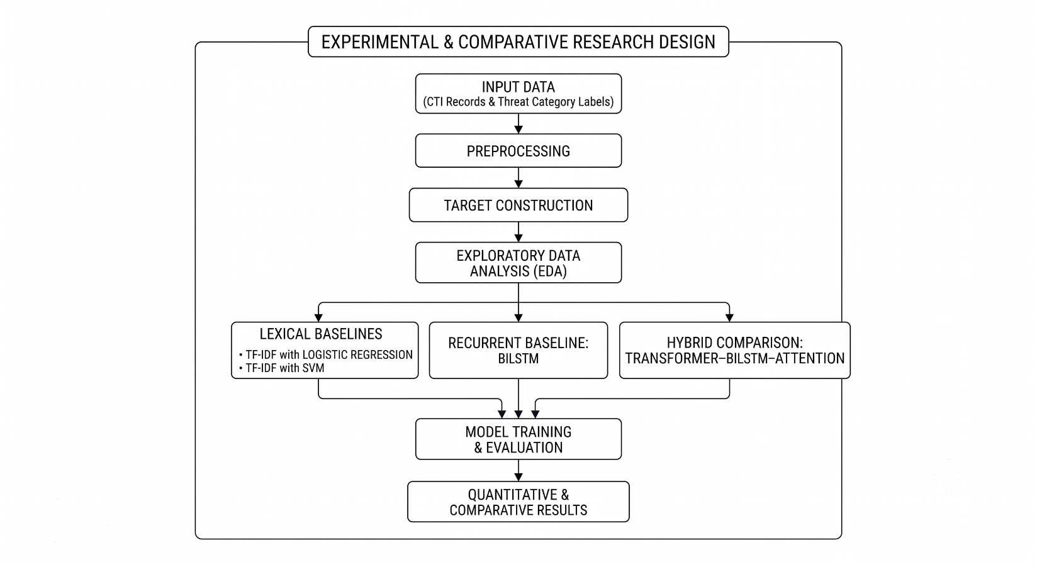
2. Project Overview
Dissertation Core Focus
Develop an automated CTI text classification system.
Convert CTI reports into document-level threat categories.
Compare classical, deep learning and hybrid models.
Support security analysts with automated categorisation.

Slide 4
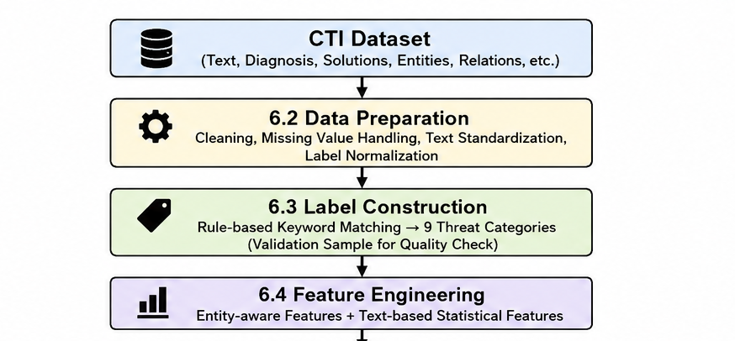
3. Dataset Description and preprocessing
Dataset Architecture & Composition
• Source : Kaggle
• Dataset Scale: total of 1,420 records
• Class Categories: Mapped to 8 major operational domains (DoS, Espionage/APT, Vulnerability, Data Breach, etc.).
Handle missing values.
Normalise entity labels.
Clean text formatting.
Combine text and diagnosis.
Prepare TF-IDF and transformer input.

Slide 5
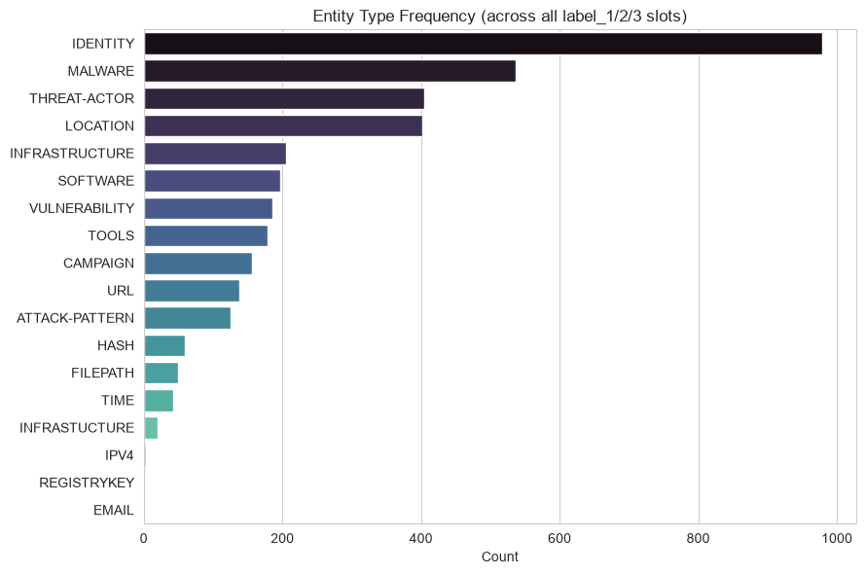
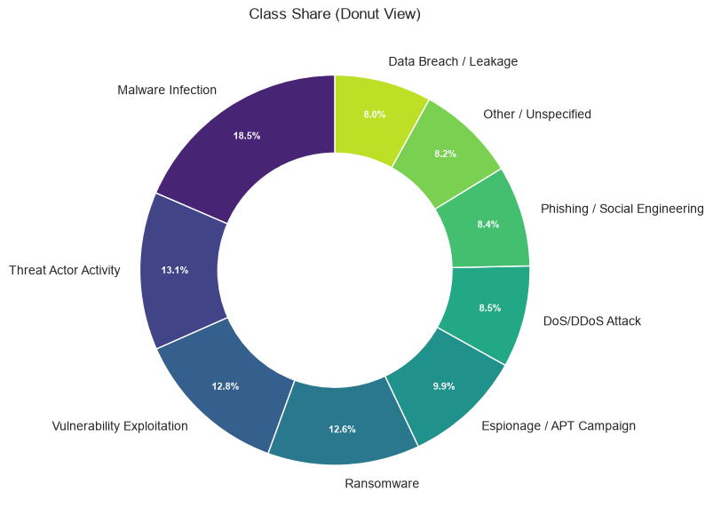
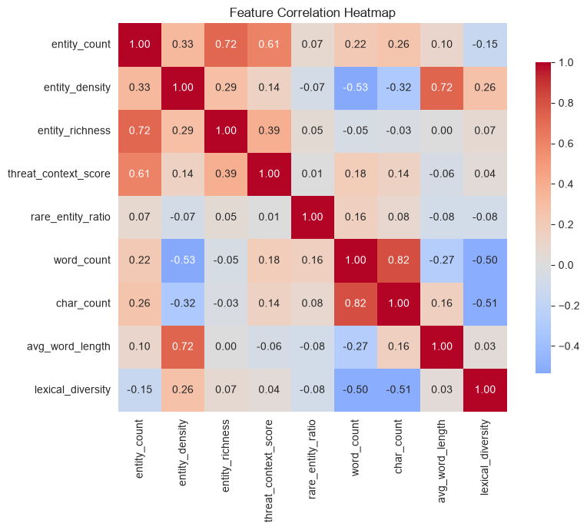
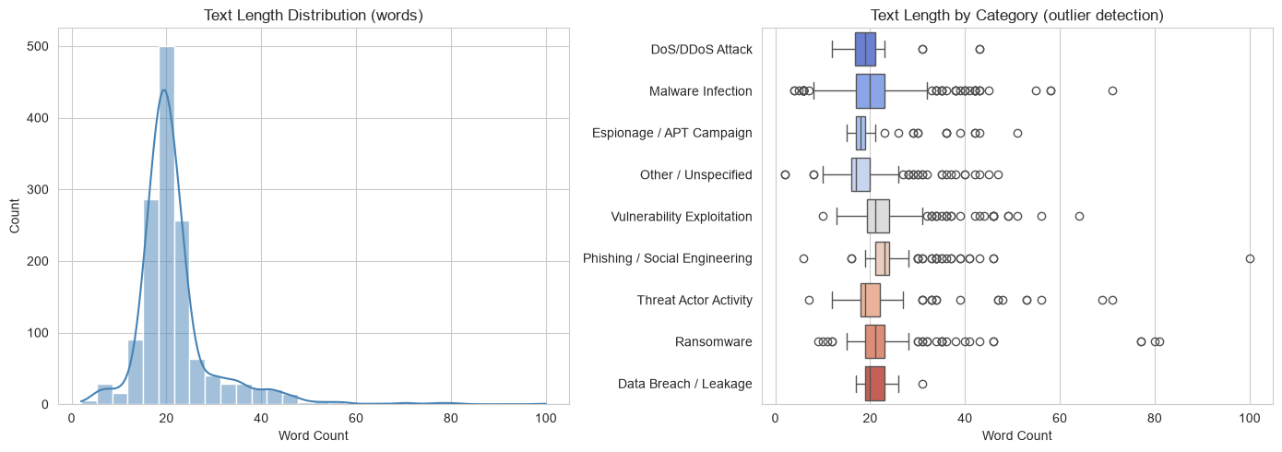
4. Exploratory Data Analysis
Profiling Class & Entity Distributions
Class distribution
Text length analysis
Entity frequency
Feature relationships
Threat category insights

Slide 6
5. Models Implemented
Baseline Classifiers Evaluated
• TF-IDF Logistic Regression: Simple linear model processing word unigrams and bigrams capped at 3,000 features.
• TF-IDF Support Vector Machine (SVM): Fitted with linear kernel as a highly robust high-dimensional lexical benchmark.
• BiLSTM (from scratch): Bidirectional LSTM trained purely on the local threat dataset without pre-trained language representations.
Proposed: SecureBERT-BiLSTM-Attention
The proposed model is structured in four specialized sequential layers to balance representation and context:
Layer 1: Encoder: SecureBERT - domain-adapted encoder pre-trained exclusively on cybersecurity-specific vocabulary.
Layer 2: Recurrent: Bidirectional LSTM - captures sequential dependencies and models context bidirectionally.
Layer 3: Attention: Additive Attention - computes learned token weights to pool sequence features interpretably.
Layer 4: Classifier: Linear Head - mapping grouped hidden representations to 8 threat category probabilities.

Slide 7
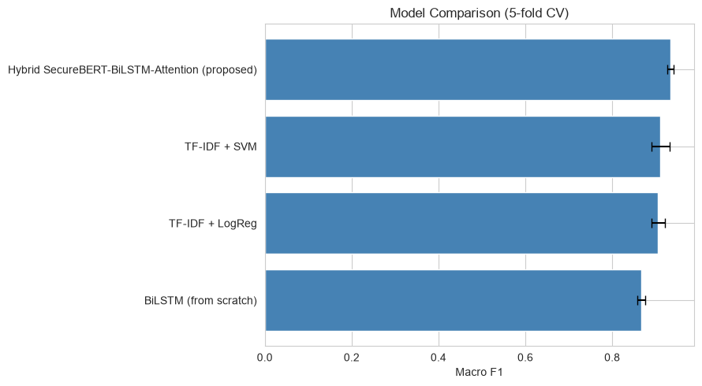
6. Evaluation ,Comparison and Best Model
Model Candidate | Accuracy | Precision | Recall | Macro-F1
BiLSTM (from scratch) | 0.8507 | 0.8716 | 0.8568 | 0.8632
TF-IDF + LogReg | 0.8937 | 0.9232 | 0.8933 | 0.9054
TF-IDF + SVM | 0.8993 | 0.9262 | 0.8979 | 0.9097
Hybrid (Proposed) | 0.9359 | 0.9422 | 0.9336 | 0.9372
Optimal Model Analysis
✔ Best Performer: The hybrid SecureBERT-BiLSTM-Attention configuration secures Rank 1 overall with a 0.9372 Macro-F1.

Slide 8
7. Conclusion
Developed a complete CTI classification workflow.
Compared multiple modelling approaches.
Proposed a SecureBERT–BiLSTM–Attention hybrid.
Evaluated and Explored classical, deep learning and hybrid models.
Foundation for future cybersecurity text classification research.

